Slide 1
ONLINE SHOPPING CART

Slide 2
OBJECTIVE
The main objective of this project is to manage the details of shopping, payment , bill, customer.

Slide 3
TECK STACK USED
FRONTEND – React Js
React is used to create interactive user interfaces. It is used to design simple views for each state in the application
BACKEND – Spring Boot
Java Spring Boot is a tool that makes developing web application and micro services with spring framework faster and easier.
DATABASE - MySQL

Slide 4
COMPONENTS
Header : The main functionality of this header is to display a shopping cart and the number of items added to the cart along with a login button for a user to login to his account and a signup button to create a user account

Slide 5
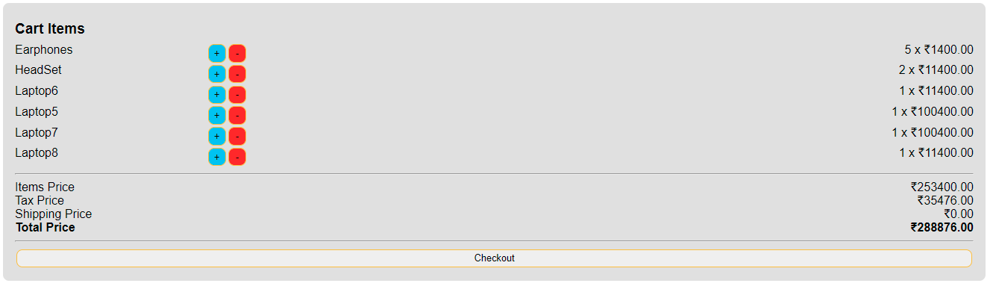
Cart : In cart we will display the items that a user want to purchase along with the details of an item. Here we will also display the total price of the items added to the cart. Here user can also increase or decrease the quantity of the item.

Slide 6
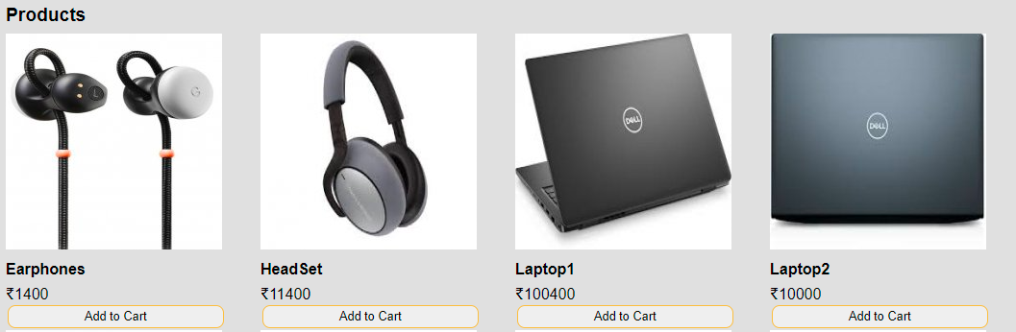
Items : Here we will display all the items and their details such as Name Price and Image of the product along with a “Add to Cart” button.
By using the Add to Cart button user can add an item to the cart.

Slide 7
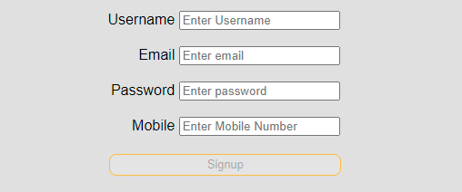
SIGN UP

Slide 8
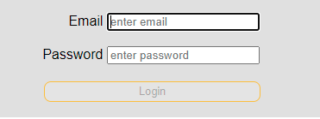
LOG IN

Slide 9
IMPROVISATIONS
Admin Page
Create a database
Signin Authentication
Singout functionality
Storing of user details into database

Slide 10
THANK YOU

